Slide 1

COURSERA IBM DATA SCIENCE CERTIFICATION – CAPSTONE PROJECT
RAVI TEJA

Slide 2
SETTING UP OF DEPARTMENT STORE IN HYDERABAD, India

Slide 3
Introduction
Over the years, the goods available for sale to the public have increased in both range and variety and now encompass everything and anything that a customer might possibly need or want. Today it is possible to purchase clothes, toiletries, cosmetics, gardening materials, sporting goods, home appliances etc under one roof called the Department Store. However, some stores have become renowned from a certain degree of specialization while others for offering goods at discount prices whereas most stores offer a general discount of prices at particular times of the year.

Slide 4
Business Problem
A retail company wants to set up Department store in Hyderabad city. But it is not exactly sure about which Neighbourhood(s) to open the store(s) in. The chosen locations should ideally have a considerable population so that there is more store footfall & near to work centers/residential districts for easier access to a large number of citizens. There are 2 business questions that need to be answered here.
Which part (area) of the city should the company open the department store first.
Which Neighborhood(s) would be ideal in that part (as in point 1) setting up such a department store in the city.
Again, the most important point not to forget would be, the area chosen shall have at most 1 Department store that exists or must have no Department store.

Slide 5
Data Description
In order to solve the business problem, I have decided to use the following data as listed below, which includes the Foursquare Location data API.
• List of neighbourhoods in Hyderabad.
• Geographical co-ordinates data of Neighbourhoods in Hyderabad city that I have scraped from Wikipedia using the BeautifulSoup which is a python package - reference link : https://en.wikipedia.org/wiki/Category:Neighbourhoods_in_Hyderabad,_India. This data would be used for collecting the Latitude, Longitude values, for Neighbourhood mapping and helps to display points on Folium based maps.
• Venue data for each Neighbourhood in the city using Foursquare API. I included venues within a 2000 meter radius from each neighborhood center. The data helps us to identify similar Neighbourhood using venues. Also helps in clustering algorithm.

Slide 6
Methodology
Web scraping Wikipedia page for neighbourhoods list
Get latitude and longitude coordinates using Geocoder
Use Foursquare API to get venue data
Group data by neighbourhood and taking the mean of the frequency of occurrence of each venue category
Filter venue category by Department Store
Perform clustering on the data by using k-means clustering
Visualize the clusters in a map using Folium
Draw the Conclusions

Slide 7
Results
Categorized the neighbourhoods into 3 clusters using K means algorithm :
Cluster 0 (green): Neighbourhoods with very less number of Department Stores.
Cluster 1 (red) : Neighbourhoods with no Department Stores.
Cluster 2 (yellow) : Neighbourhoods with a high concentration of Department Stores

Slide 8
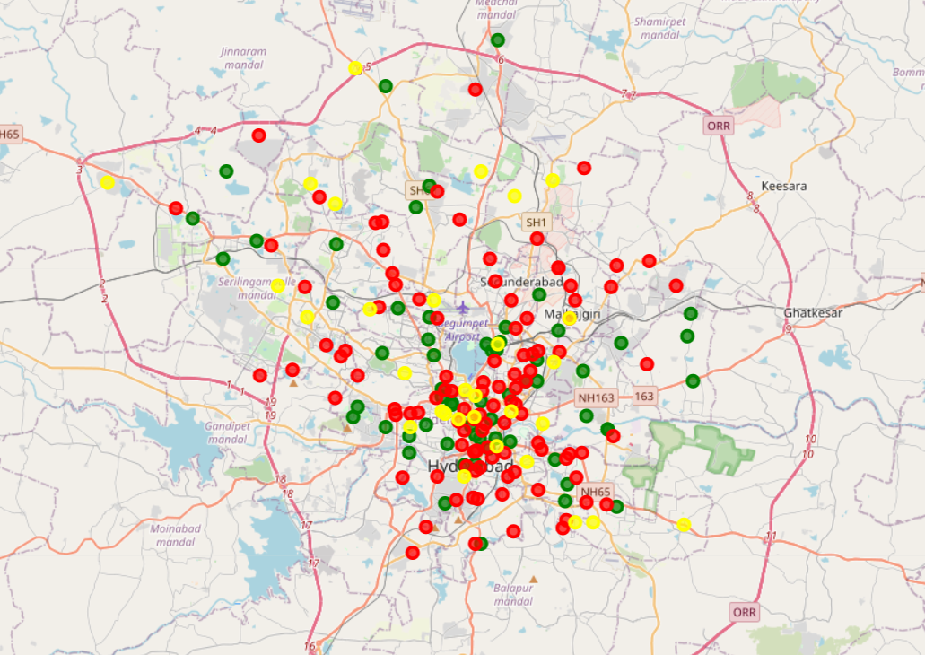

Slide 9
Discussions
Based on our analysis above, we can draw a number of conclusions that will be useful to aid property developers and investors for setting up of the Department Store.
After collecting data from the Wikipedia (data of neighborhoods) & Foursquare (data of venues) , we got a list of 168 different venues. However, as we want to only focus on the data of Department Store, we created a separate DataFrame for the data of department stores.
We identified that from the data, there are 91 total department stores in central Hyderabad. Also after further analysis we find that there are at most 3 department stores in some of the neighborhoods and some doesn't even have one.
Finally, we had separated the neighbourhoods into three Cluster with the help of K-means which is an unsupervised Machine Learning Algorithm.
1. Cluster - 0 : Consists of neighbourhoods with at most 1 Department Store.
2. Cluster - 1 : Consists of neighbourhoods with no Department store.
3. Cluster - 2 : Consists of neighbourhoods with at most 3 Department Store.

Slide 10
Conclusion
A good number of Department Stores are concentrated in the central area of Hyderabad city, with the highest number in Cluster - 2 and moderate number in Cluster-0. This represents a great opportunity and high potential areas to open new Department Store as there is very little to no competition from existing stores. Meanwhile, department stores in Cluster - 2 are likely suffering from intense competition due to oversupply and high concentration of stores. Therefore, this project recommends property developers to capitalize on these findings to open new Department Store in neighbourhoods in Cluster - 1 with little to no competition. Property developers with unique selling propositions to stand out from the competition can also open new Department Store in neighbourhoods in Cluster - 0 with moderate competition. Lastly, Property Developers, Investors and other Retailers are advised to avoid neighbourhoods in Cluster - 2 which already have a high concentration of department stores and suffering from intense competition.

Slide 11


